Slide 1
Chapter 2 - Tokens and Embeddings

Slide 2
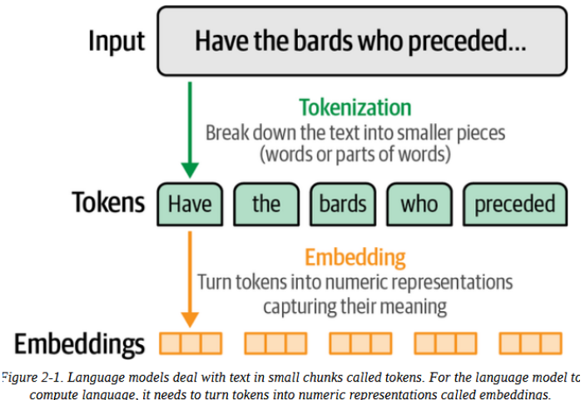
LLMs Central Concepts
Understanding tokens and embeddings are foundational and necessary to understand LLMs

Slide 3
LLM Tokenization
Most people interact with language models via web chat interfaces.
This leads to assumptions about direct input processing.
But..
Before a prompt gets processed, the language model uses a tokenizer to break it into pieces.

Slide 4
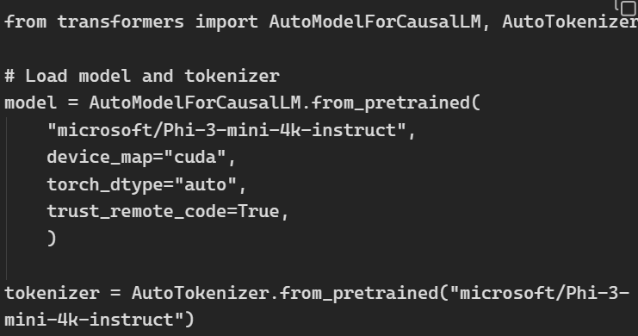
How Tokenizers Prepare the Inputs to the Language Model
Let's start by loading our model and its tokenizer:
The model we’re using is Phi-3-4k.
At the bottom, you can see the tokenizer being loaded.
Every LM has a tokenizer of its own

Slide 5
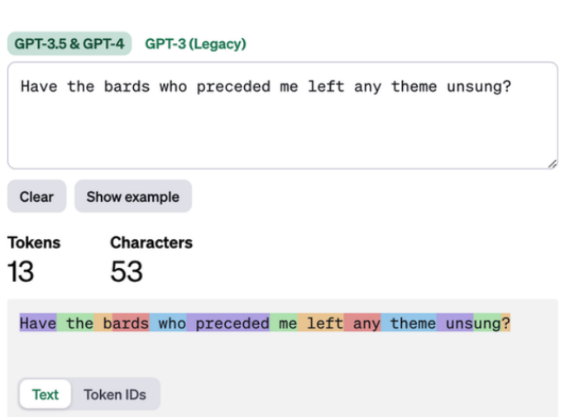
How Tokenizers Prepare the Inputs to the Language Model
See how GPT-4 tokenizer works
Some are full words
Some are parts of words

Slide 6
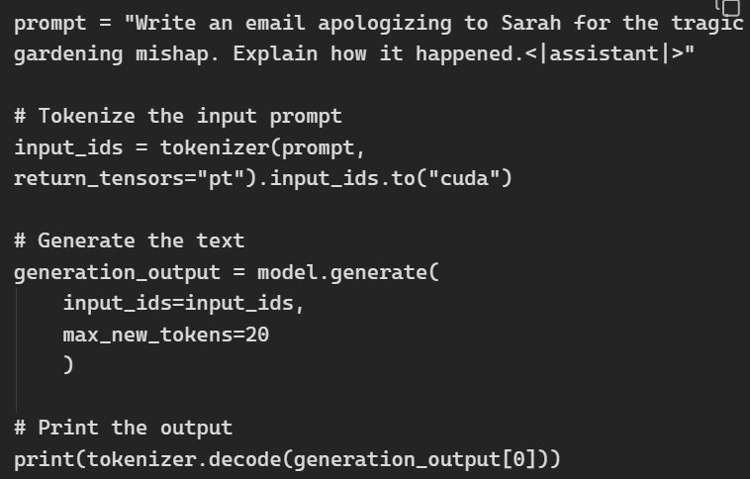
How Tokenizers Prepare the Inputs to the Language Model
Checking the code, we see:
The model receives processed input from tokenizers, not the raw text prompt.
Tokenizers convert the prompt into `input_ids` for the model.

Slide 7

How Tokenizers Prepare the Inputs to the Language Model
If you print `input_ids`, you will see a nectar of token ids of input tokens
This is what goes into the language model for training and generation

Slide 8
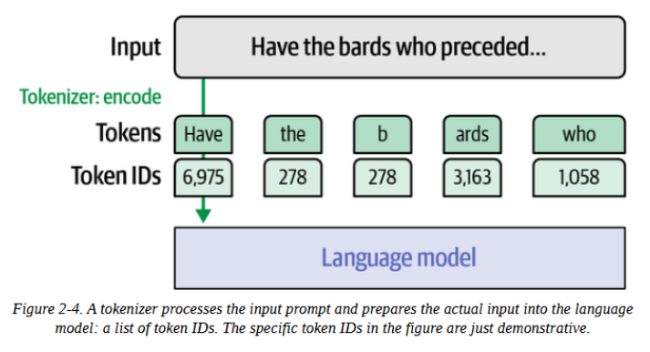
How Tokenizers Prepare the Inputs to the Language Model
This is what goes into the language model for training and generation. See the illustration above.

Slide 9
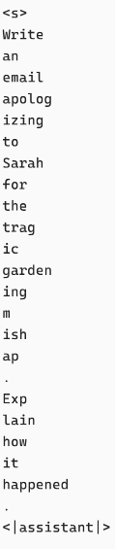

How Tokenizers Prepare the Inputs to the Language Model
To inspect what those tokens in the vector are, we can use the code provided
The long list on the right part of this slide shows every single token.
Notice that it starts with <s>, a special token
We can also see full and partial words, and punctuations

Slide 10

How Tokenizers Prepare the Inputs to the Language Model
Just like the input tokens, we can also inspect the output tokens using `generate_output`:
The LLM output starts from `3323`
Running that would give you:

Slide 11
How Does the Tokenizer Break Down Text?
There are three major factors:
The tokenization method: Popular methods are byte pair encoding (BPE), and WordPiece
Design Choices: like vocabulary size, and special tokens
Training Data: The tokenizer needs to be trained on a specific dataset to create the vocabulary.

Slide 12
Word Versus Subword Versus Character Versus Byte
Word tokens:
Common in earlier methods like word2vec
Unable to deal with new words
A special token would be use for unknown words (e.g., [UNK]) which means nothing to the model
Unknown tokens would also mean new words have little or no difference, making the model generate incorrect or incomplete responses
Example: ‘The cat sat’ -> ‘the’, ’cat’, ’sat’

Slide 13
Word Versus Subword Versus Character Versus Byte
2. Subword tokens:
As seen in GPT-4 tokenizer, it tokenizes full or partial words.
Able to tokenize most new words by breaking them to subwords (e.g., apolog, critic, ize, etic, )
Example:
‘Unsung Hero’ -> ‘Un’, ‘sung’, ‘hero’

Slide 14
Word Versus Subword Versus Character Versus Byte
3. Character tokens:
Can deal with new words successfully
Makes tokenization more straightforward
But makes modeling more difficult
Requires higher context length for the same input length, compared to WordPiece, for example.
Example: `play` would be 1 token in word token
It would be 4 tokens (‘p’, ‘l’, ‘a’, ‘y’) as character tokens

Slide 15
Word Versus Subword Versus Character Versus Byte
3. Byte tokens:
Represents text as raw bytes (0-255)
Can handle any text, or language, or symbol, without needing special tokens or vocabulary
Requires higher context length for the same input length,
Creates really long sequences

Slide 16
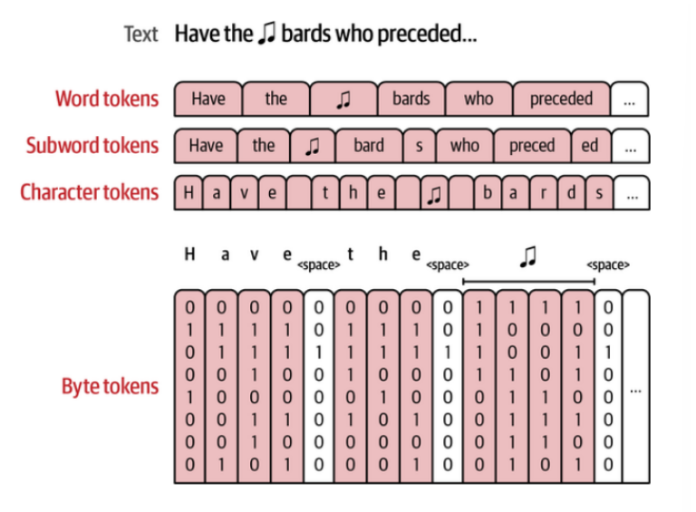
Word Versus Subword Versus Character Versus Byte
The image shows different tokenization types

Slide 17
Tokenizer Properties
Tokenization Methods: BPE, WordPiece, SentencePiece. More info here
Tokenization Parameters:
Vocabulary size: # of tokens in the tokenizer’s vocabulary
Special tokens: Examples are [CLS], [SEP], <s>. Mostly used to indicate a structural characteristic
Capitalization: Each tokenizer handles capital/small letters differently. Could affect model’s understanding (Apple vs apple)

Slide 18
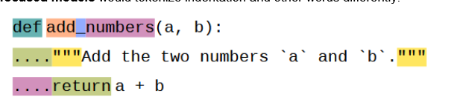
Tokenizer Properties
The domain of data : Tokenizers will perform based on the data domain they were trained on.
Example: Code-focused models would tokenize indentation and other words differently:

Slide 19
Tokenizer Embeddings
Embeddings are the numeric representation space used to capture meanings and patterns in language
After a tokenizer is initialized and trained, it is used in the training of a language mode
Which is why language models are linked to their own tokenizer.

Slide 20
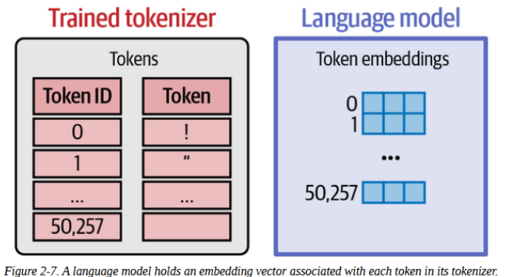
Tokenizer Embeddings
The LLM maps each token to an embedding vector.
Embedding values are learned/refined during the training process of the LLM

Slide 21
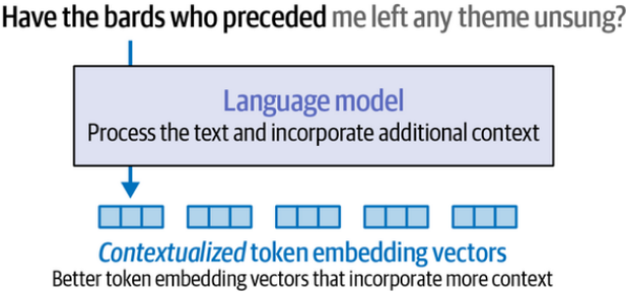
Creating Contextualized Word Embeddings with Language Models
Instead of representing a single word or token with a static vector, language models create word embeddings of the words based on the entire input.
This takes context into account.

Slide 22
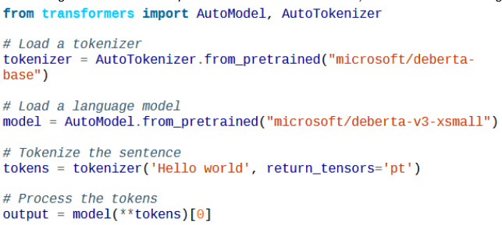
Creating Contextualized Word Embeddings with Language Models
Let's look at an example of how we can generate contextualized word embeddings:

Slide 23




Creating Contextualized Word Embeddings with Language Models
Let’s inspect the variable
This prints out:
To see the 4 vectors:
we can read this as four tokens, each one embedded
in a vector of 384 values (or dimensions) on the left
We can see the 4 vectors on the right:

Slide 24
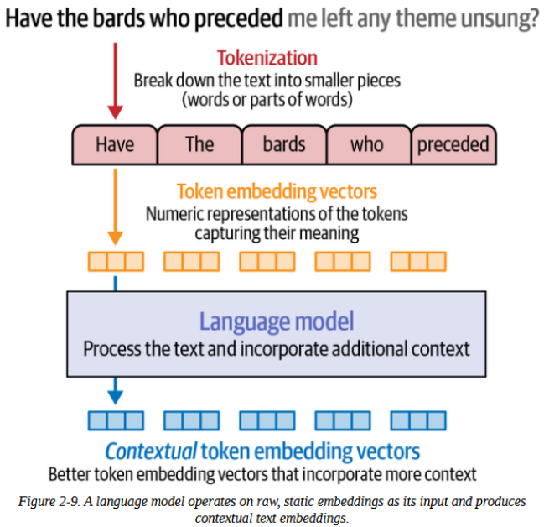
Creating Contextualized Word Embeddings with Language Models
The text is first tokenized
The meaning of each token is represented in embedding vector
Lastly, these embedding tokens are used as input by a language model to create contextual token embeddings

Slide 25
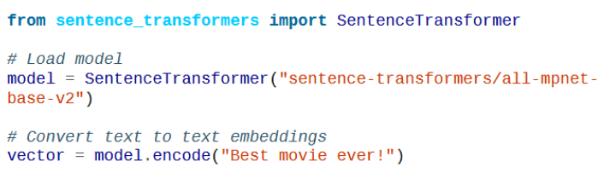
Creating Contextualized Word Embeddings with Language Models
We will use the all-mpnet-base-v2

Slide 26
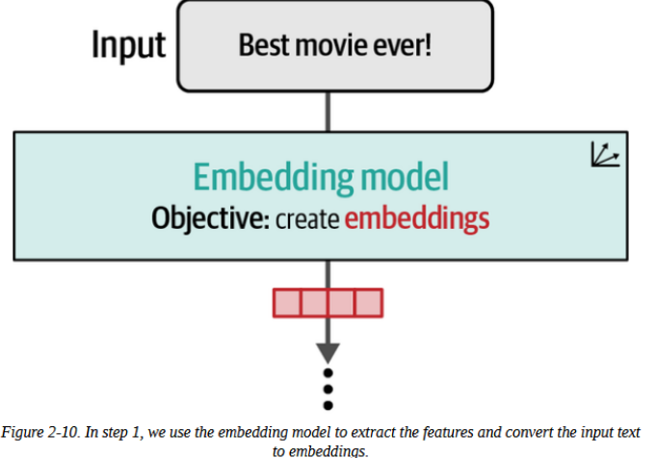
Text Embeddings (for Sentences and Whole Documents)
One way to produce text embedding is by averaging the values of all the token embeddings.
But high-quality text embedding models are trained for text this
We can produce text embeddings with sentence-transformers .

Slide 27


Creating Contextualized Word Embeddings with Language Models
To see the values and dimensions of the resulting vector embedding, use:
Which prints out:
In contrast to the previous one with 4 vector embeddings, this one resulted to 1 vector (for the entire input) embedding of 768 dimensions.

Slide 28
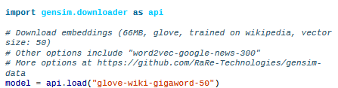
Word Embeddings Beyond LLMs
Using pretrained Word Embeddings
Let’s look at how we can download pretrained word embeddings (like word2vec or GloVe) using the Gensim library:

Slide 29

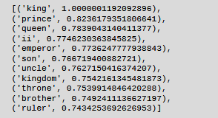
Using pretrained Word Embeddings
We’ve downloaded the embeddings of a large number of words trained on Wikipedia.
We can explore the embedding space by seeing the nearest neighbors of the word “king” for example:
This outputs:

Slide 30
The Word2vec Algorithm and Contrastive Training
Word2vec algorithm described in “Efficient estimation of word representations in vector space”
Described in detail by the book’s author in The Illustrated Word2vec.
The algorithm uses a sliding window to generate training examples.
For example, a window size of 2 means we consider 1 word before and 1 word after a central word.

Slide 31
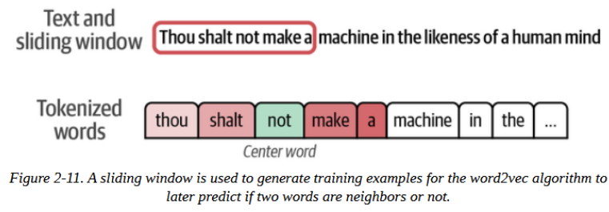
The Word2vec Algorithm and Contrastive Training
A classification task is used to train a neural network that predicts is words commonly appear in the same context or not
The sliding window and window size (4 in this example) is illustrated in the below image:

Slide 32
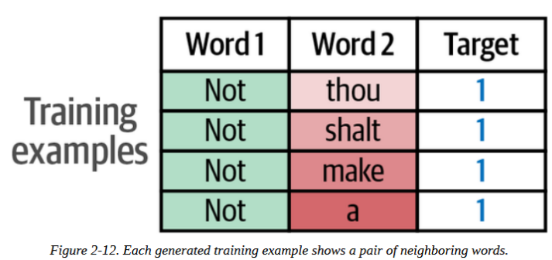
The Word2vec Algorithm and Contrastive Training
The central word is used as one input, and each of its neighbors is a second input in each training example.

Slide 33
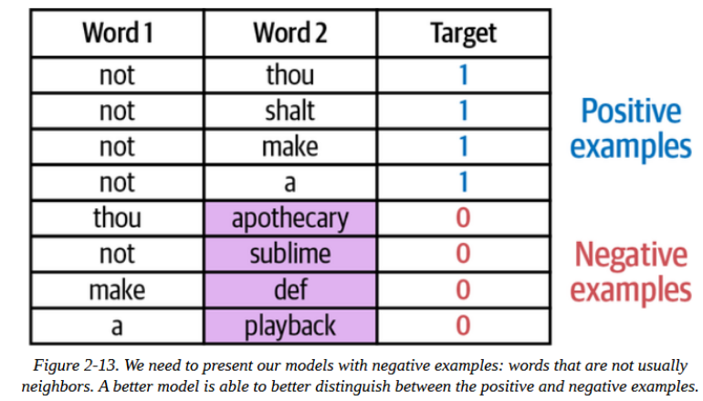
The Word2vec Algorithm and Contrastive Training
A problem in training word2vec is that if we only show the model positive examples (actual neighboring words), it could achieve perfect accuracy by always predicting "yes".
To address this, the training data have negative examples

Slide 34
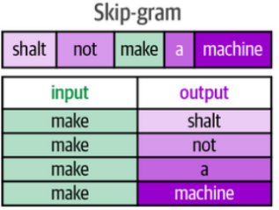
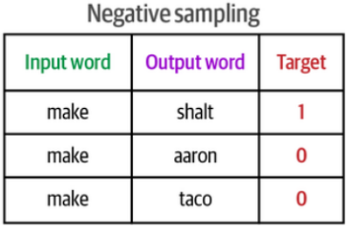
The Word2vec Algorithm and Contrastive Training
Simply pairing words randomly from the vocabulary works well, called negative sampling inspired by noise-contrastive estimation
Combined with skip-gram (selecting actual neighboring words), these are word2vec's core training strategy

Slide 35
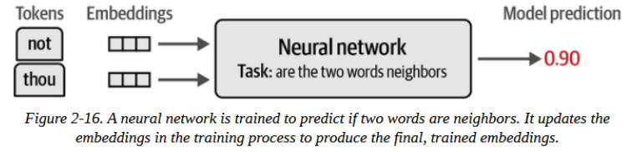
The Word2vec Algorithm and Contrastive Training
The process generates millions or billions of training examples from text, requiring initial decisions about tokenization, capitalization, and vocabulary size.

Slide 36
END

